Slide 1


Slide 2
FUN WITH PAINT

Slide 3

Paint
Paint is used for drawing, coloring and editing the pictures.
It can save creations in standard formats such as .jpg or .png
There are 2 ways to open paint on a computer

Slide 4
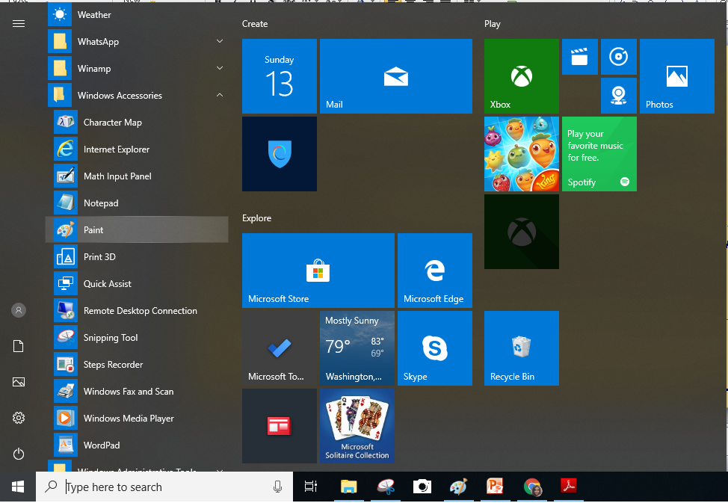
1st way:-
Click on start and scroll down to windows accessories
In it you will find paint, double click on it.

Slide 5
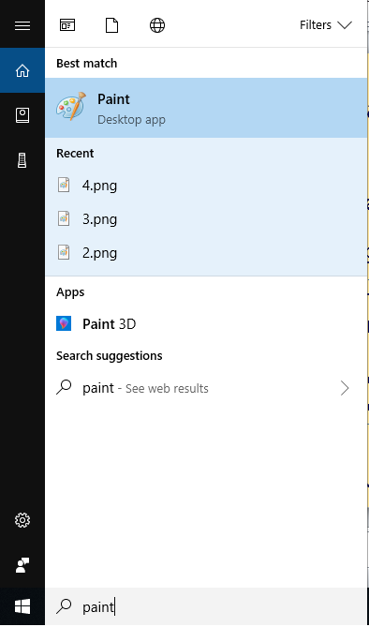
2nd way:-
Type the name “paint” in the search box next to start button.
You will see paint as the best match in search result, double click on it.

Slide 6
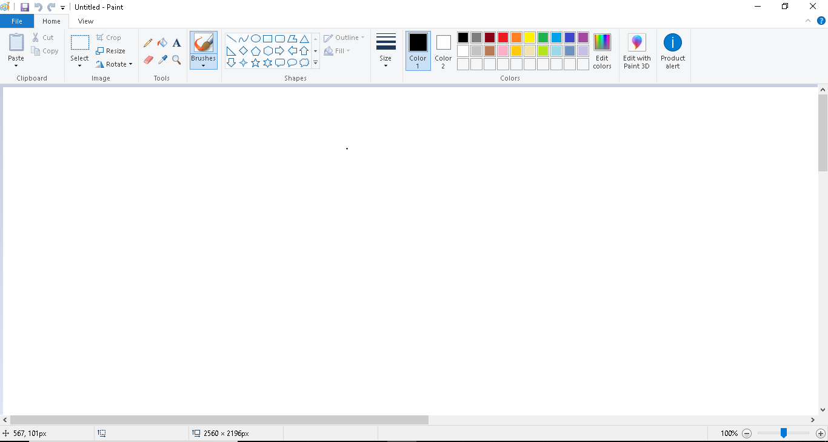
Shapes
Paint brushes
Color plate
Tool panel

Slide 7

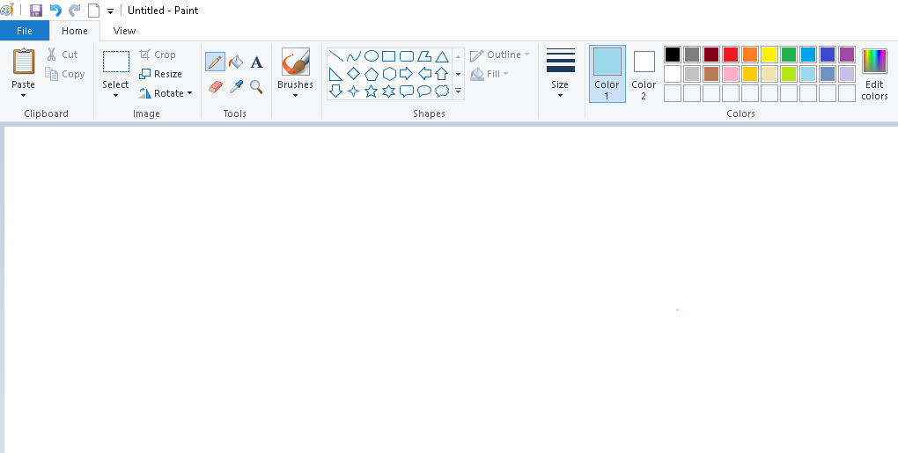

Drawing using pencil
1.Click the pencil tool in the tool box.
2. Select a color from the color box.
3. You can change the thickness of the line by selecting the lines given in the line patterns.
4. Now click at any point on the white sheet and drag the mouse to draw shape you want.

Slide 8

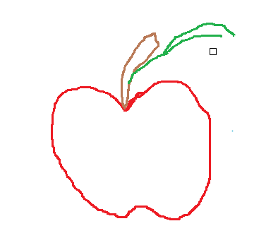
Using eraser
1. Select the eraser tool from toolbox.
2. Increase the size of the eraser
from size line given in the tool box (if you want more larger size that you can use ctrl and + key to increase size).
3. Hold the eraser where you want to
erase a part of the image or whole
image.

Slide 9


Fill with color
1. Select a fill with color tool from toolbox.
2. Choose a color you want to fill in a picture from color platelets.
3. Click fill with color tool in the image.

Slide 10

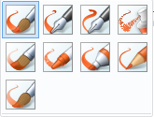
Using brushes
1.This tool paints the image with various kinds of brushes available in toolbox.
2. Click on the brushes tool and select type of brush you want.
3. Select color from color panel and color the shape you want.

Slide 11

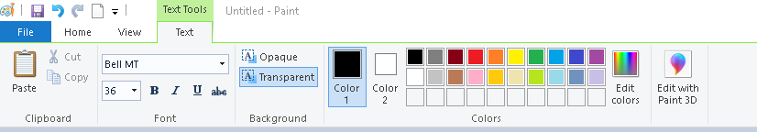

Adding text to paint
1. Click the text tool in the tool box.
2. Create a text frame by clicking and
dragging the mouse pointer across.
3. Then Text tab will be appear on the
top as menu shown above.
4. Choose the font style, size from the
font toolbar.
5. Click in the text frame, and type your text.
6. To change the color of the text, click a color in the color box.

Slide 12



Drawing using shapes
To draw different shapes click on the shape you want to draw
drag the pointer across the drawing area.
You can also color shape the by using color fill color or paint brushes

Slide 13

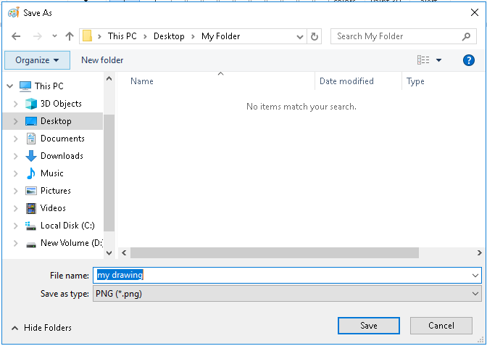
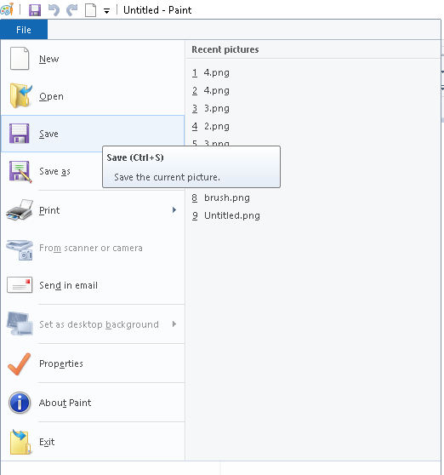
Save a drawing
Click on the file option in the left corner.
Click on save and select the folder you want to save in
Give your drawing a name and click on the save button.

Slide 14


